Slide 1

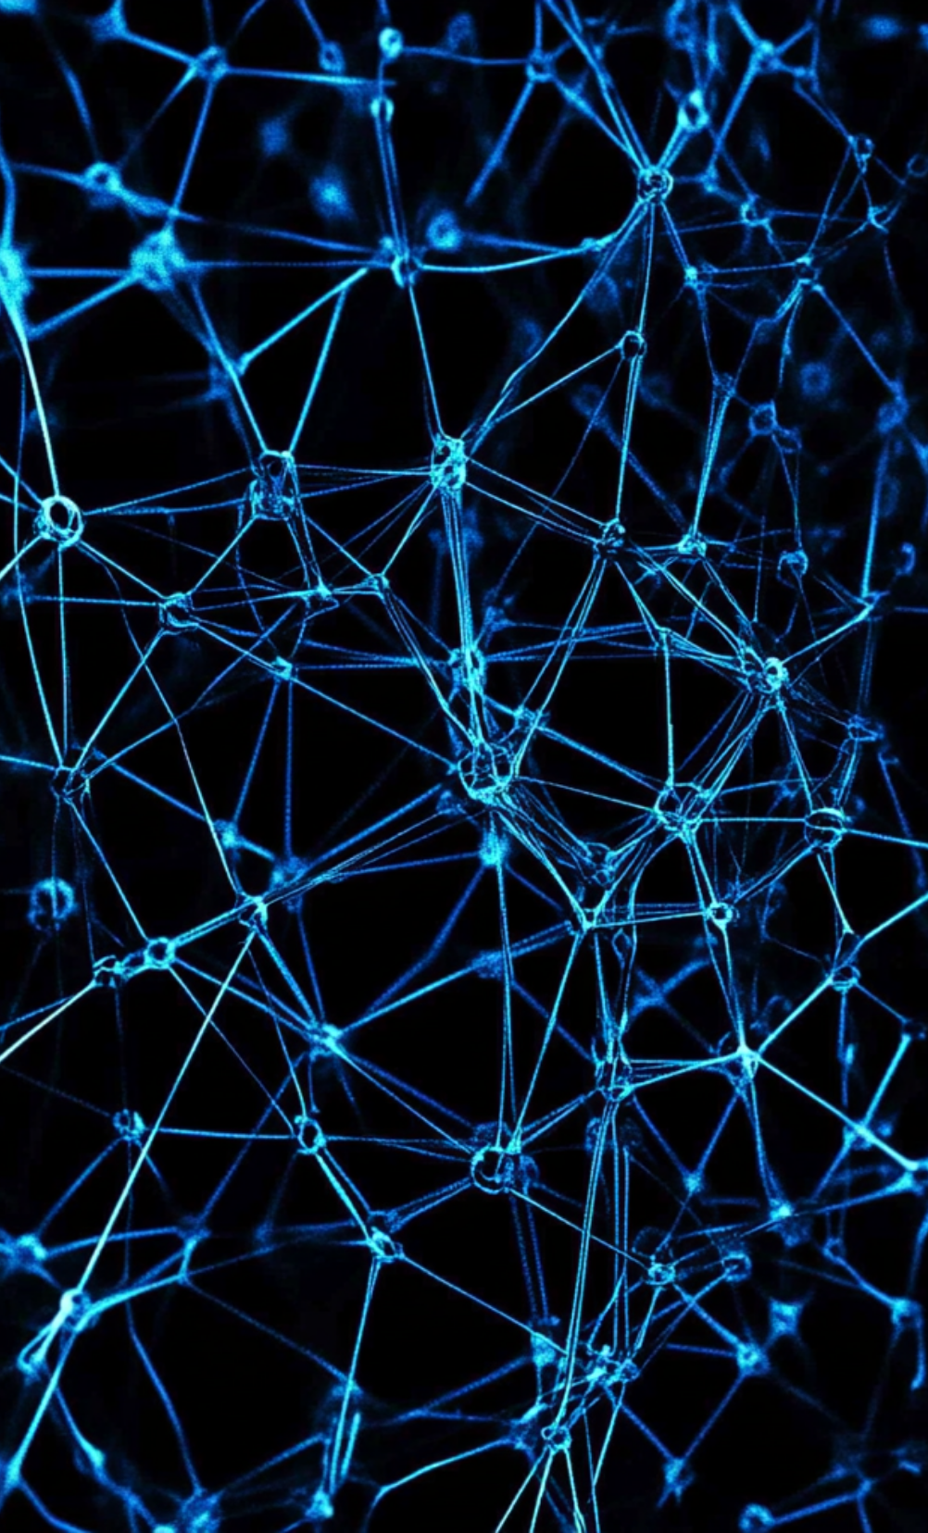
Laplacian of Gaussian in Computer Vision
Laplacian of Gaussian (LoG) is a vital technique in computer vision, primarily used for edge detection and feature extraction. It combines the Laplacian operator and Gaussian smoothing to identify areas of rapid intensity change in images.

Slide 2
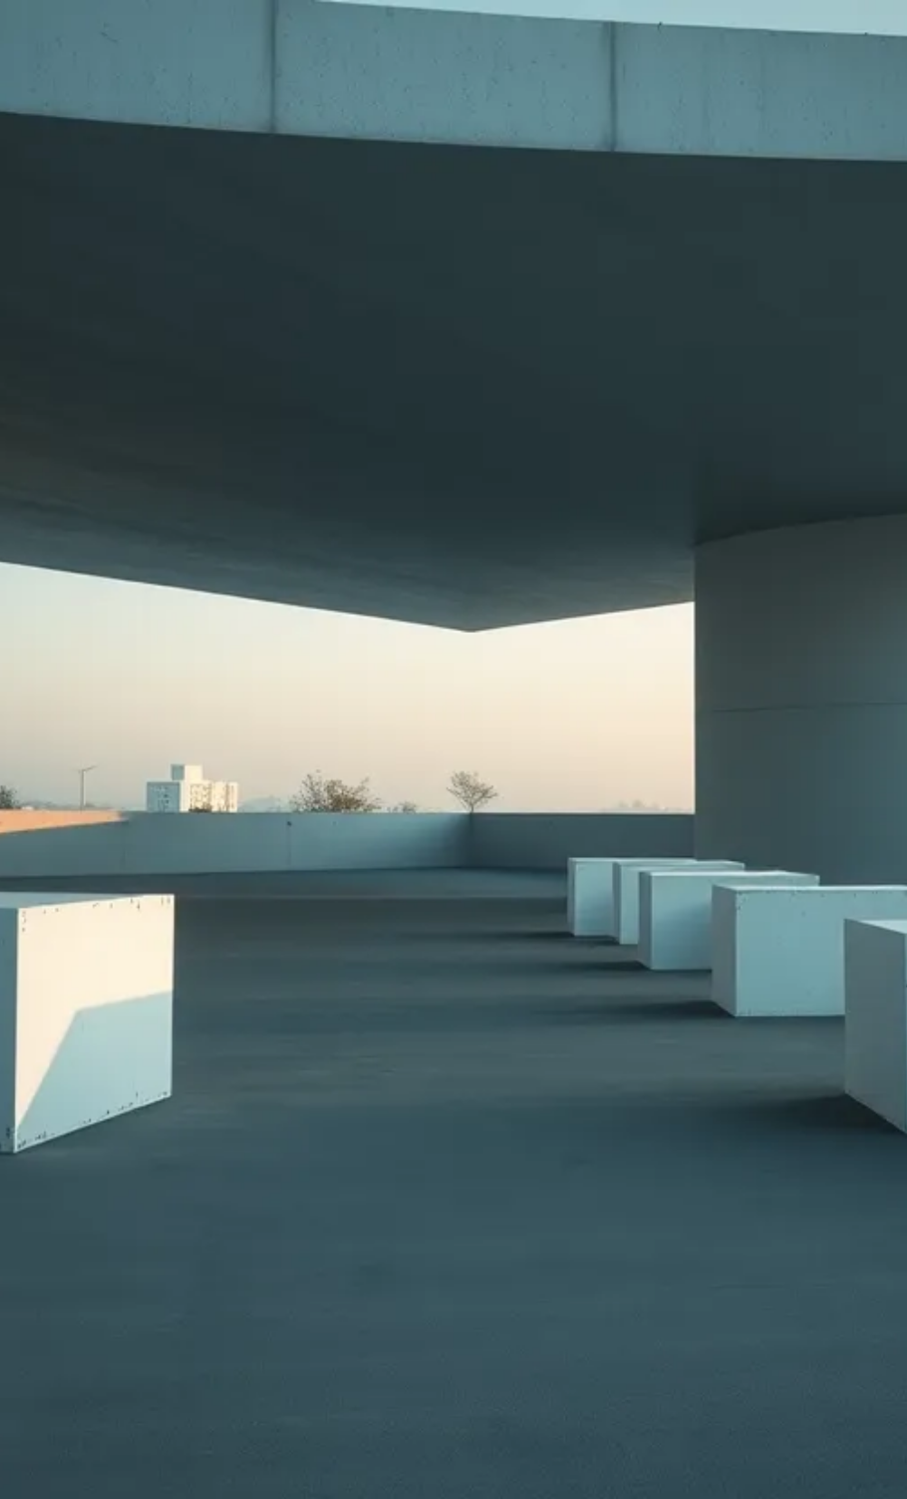
Introduction to Laplacian of Gaussian (LoG)
Definition
The Laplacian of Gaussian (LoG) is an operator used in computer vision, combining Gaussian smoothing and the Laplacian operator.
Purpose
LoG enhances image features by identifying rapid intensity change, essential for edge detection and object recognition.
Applications
Commonly used in image processing tasks such as edge detection, texture analysis, and image segmentation.

Slide 3


Mathematical Foundation
1
Gaussian Function
2
Laplacian Operator
3
LoG Formula
The Gaussian function smooths the image, reducing noise and detail, and is defined as G(x,y) = \frac{1}{2\pi\sigma^2} e^{-\frac{x^2+y^2}{2\sigma^2}}.
The Laplacian is a second-order derivative operator that highlights regions of rapid intensity change, represented as \nabla^2 f.
The LoG operator is expressed mathematically as LoG(x,y) = \nabla^2 G(x,y), integrating both smoothing and edge detection functionalities.

Slide 4



Implementation Steps for Image Processing
1
2
3
Image Smoothing
Applying the Laplacian
Post-Processing
Initially, a Gaussian filter is applied to the image to reduce noise and detail.
The Laplacian operator is applied to the smoothed image to detect regions of rapid intensity change.
Thresholding is applied to classify the detected edges, resulting in a binary edge map for easier analysis.

Slide 5
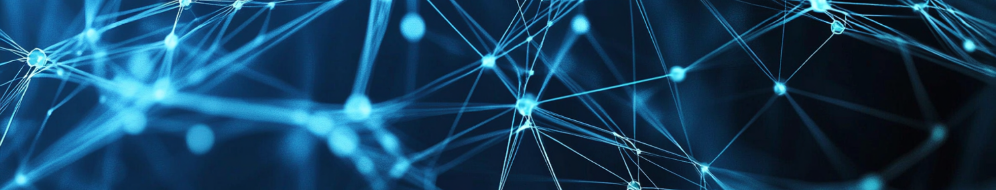

Advantages of LoG
Noise Reduction
Multi-scale Edge Detection
Robustness
LoG effectively reduces noise while detecting edges.
Offers more robust feature extraction in various lighting conditions.
Detects edges at multiple scales by adjusting the Gaussian standard deviation.

Slide 6



Comparison with Other Methods
LoG vs. Canny Edge Detector
2
LoG offers faster processing for simple edge detection tasks.
LoG vs. Sobel Filter
1
LoG provides better noise reduction and multi-scale edge detection capabilities.
Trade-offs
3
LoG balances simplicity and performance for resource-limited applications.

Slide 7
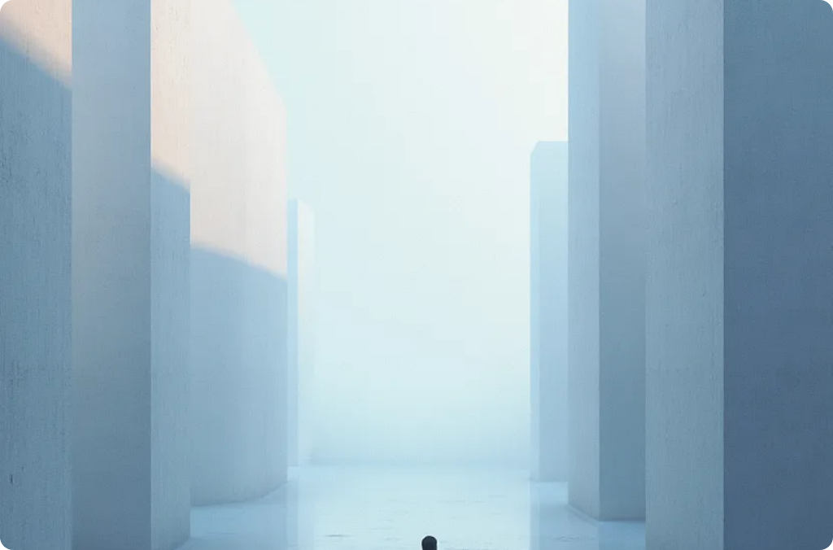

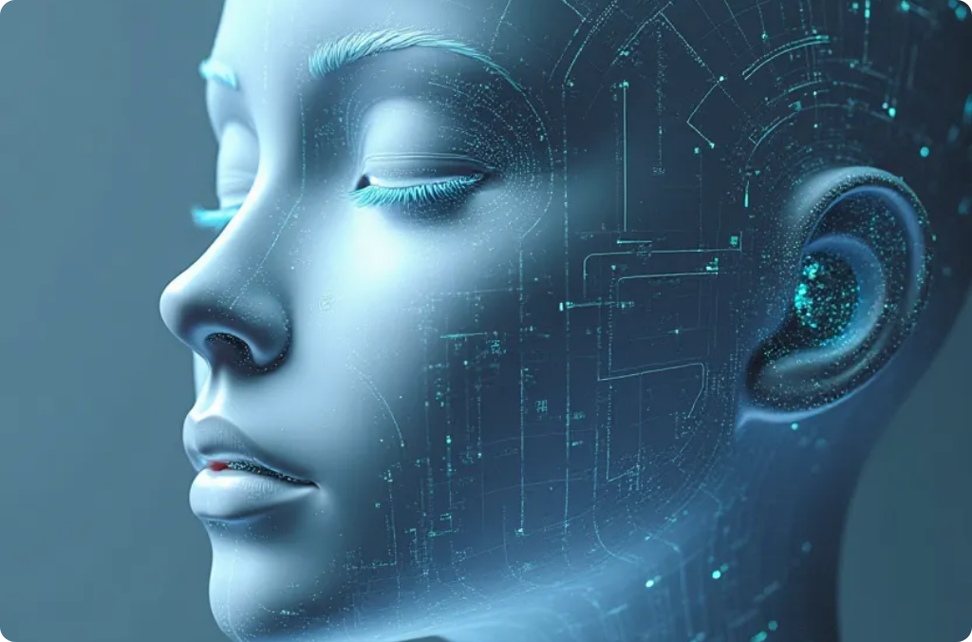
Applications in Computer Vision
Object Detection
Image Segmentation
Facial Recognition
LoG is instrumental in identifying edges of objects, aiding in localization and detection.
In segmentation tasks, LoG effectively delineates object boundaries for further analysis.
LoG can be employed in systems by detecting features relevant to identity verification.

Slide 8



Challenges and Limitations of LoG
Computational Complexity
2
For high-resolution images, the computational cost of applying LoG can be significant, necessitating efficient implementations.
Parameter Sensitivity
1
The effectiveness of LoG is sensitive to the choice of Gaussian standard deviation, requiring careful tuning for optimal results.
Edge Linking
The results of LoG may require further processing for edge linking to ensure continuity and accuracy in detected edges.
3

Slide 9



Future Directions of LoG
Integration with Deep Learning
Real-time Applications
Adaptive Methods
Developing optimized algorithms for real-time processing of video feeds can expand the use of LoG in dynamic environments.
Research into adaptive methods for adjusting the Gaussian parameters dynamically based on image content could improve robustness.
Combining LoG with deep learning techniques may enhance feature extraction and improve performance in complex visions tasks.

Slide 10




Conclusion of Laplacian of Gaussian
The Laplacian of Gaussian is a powerful and fundamental technique in computer vision, merging image smoothing with edge detection. Its robustness and effectiveness in various applications continue to make it a relevant tool in both academic research and practical implementations.
Merging Methods
Combines image smoothing with edge detection.
Powerful Technique
Robustness and Effectiveness
A fundamental method in computer vision.
Applicable in diverse scenarios.
2
1
3

